Slide 1
Notes:
SHEIKHOO SUGAR MILLS LTD.

Slide 2
IMPLEMENTATION OF ENERGY MANAGEMENT SYSTEM IN SUGAR INDUSTRY
PRESENTATION ON
ABDULLAH AMMAR CHIEF ENGINEER ELECTRICAL SHEIKHOO SUGAR MILLS LIMITED, KOT ADDU

Slide 3
Energy is the lifeline of a nation. The economic engine and the wheels of industry need the energy to move forward. Energy Management is the Judicious and Effective Use of Energy to Maximize Profits (Minimize Costs) and Enhance Competitive Positions. ISO 50001 is the International Standard for Energy Management System. An energy management system, otherwise known as an EnMS, is a set of policies and procedures put into practice to track, analyze, and plan for energy usage using the popular Plan-Do-Check-Act method of continual process improvement. Apart from costs, energy usage contributes to climate change as well. The scope of energy management system is also productive in sugar industry. The implementation of optimized power generation and utilization is explained with case study. This Paper aims to discuss the benefits of energy management system in sugar industry in terms of economy, environment and sustainability.
ABSTRACT

Slide 4
ENERGY MANAGEMENT SYSTEM
Determines the most cost-effective configuration of power generation, transmission, and Utilization throughout the network, considering the required criteria for system stability, safety, and reliability
Provides the fundamental information and computation capability to perform real-time network analyses
Provide strategies for controlling system energy flows, and to determine the most economical mix of power generation and Utilization

Slide 5
OBJECTIVES OF ENERGY MANAGEMENT SYSTEM
To achieve and maintain optimum energy utilization throughout the organization
To minimize energy costs without affecting production and quality
To reduce import dependency/fuel in case of self generation
To enhance energy security, economic competitiveness and environmental quality

Slide 6
PDCA CYCLE OF EnMS

Slide 7
PDCA CYCLE OF EnMS
Energy Management System is based on Plan-Do-Check-Act (PDCA). PDCA is an iterative four-step management method used in business for the control and continual improvement of processes and products. It Provides a framework to:
Develop a policy for more efficient use of energy
Fix targets and objectives to meet the policy
Use data to understand and make decisions about energy use
Measure the results
Review how well the policy works
Continually improve energy management.

Slide 8
POWER GENERATION OPTIMIZATION AT SSML
At SSML, we adopt several power generation topologies as per the requirements to optimize the power generation.
Total Installed capacity is 79 MW
HP Power House capacity is 52 MW
LP Power House capacity is 27 MW
Both Power Houses Synchronized through 31.5/40 MVA Power Transformer
The figures shows the different schemes of power generation with auto Power sharing

Slide 9
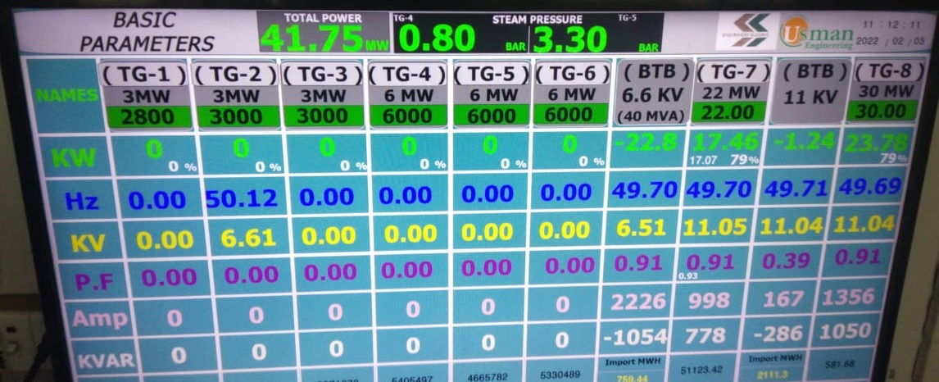
POWER GENERATION OPTIMIZATION AT SSML

Slide 10
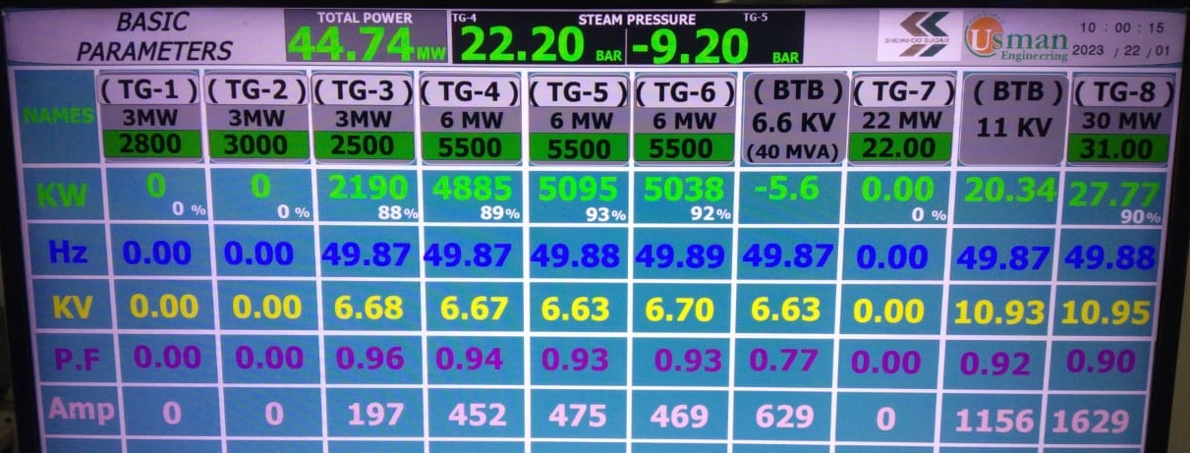
POWER GENERATION OPTIMIZATION AT SSML

Slide 11
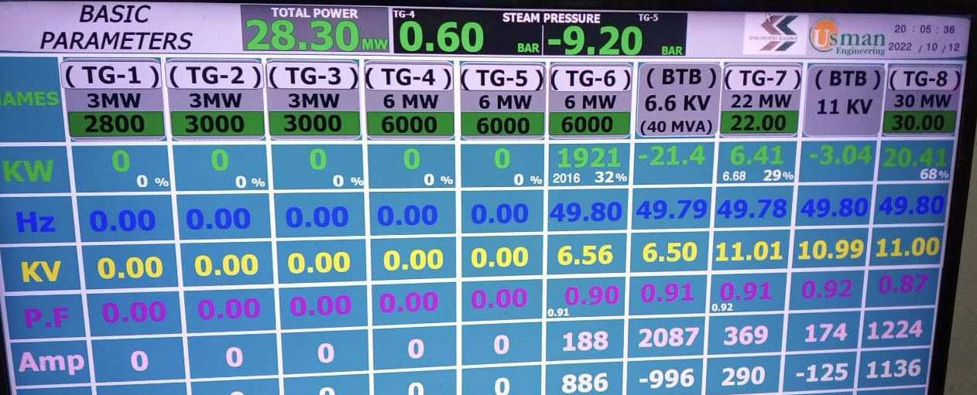
POWER GENERATION OPTIMIZATION AT SSML

Slide 12
CASE STUDY: FEEDING TABLE MOTORS
For total number of six Feeding Tables, the motors installed at the feeding tables are 90 KW Variable Speed Motors. The feeding table Motors runs continuously for 24-Hours but the carrier runs for almost 16-Hours. The Motors run idle for almost 08-Hours per day. As the idle motor draw almost 52 Amp current and consumes 30.6 KW power, The extra power consumed by one feeding table is almost 245 KWH/day.
The total extra power consumed by six feeding tables is 1470 KWH/day.
When these motors are replaced by 75 KW Motors with VFDs, The 1152 KWH/day power is also saved due to the installation of VFDs.
The total power saved by replacing the motors and installing VFDs at feeding table is almost 2622 KWH/day.

Slide 13
CASE STUDY: FEEDING TABLE MOTORS
Total power saved per day = 2.622 MWH
Total power saved in 100 days = 262.2 MWH
Steam Used to produce 262.2 MWH = 1573 Ton
Bagasse required for 1573 Ton Steam = 715 Ton
Total Saving during one season is almost PKR.4.290 Millions

Slide 14
CASE STUDY: FEEDING TABLE MOTORS
ENERGY SAVING AT FEEDING TABLES
Feeding Table Motors and VFDs
 |  | Current Installed Motors |  |  |  |  |  | New Motors & VFDs
Sr. No. | Motor Name | Rated Power (KW) | Rated Current (A) | ON load Running Current (A) | NO load Running Current (A) | No load Running Power (KW) | Extra Power Consumed per day (KWH) | New Motor Rated Power (KW) | New Motor Rated Current (A) | Energy saved by Replacing Motors (KWH/day) | Energy saved by VFDs (KW) | Energy saved by VFDs (KWH/day) | Total Energy saved (KWH/day)
1 | Feeding Table No.1 | 90 | 153 | 95 | 52 | 30.6 | 245.0 | 75 | 127 | 245.0 | 12 | 192 | 437
2 | Feeding Table No.2 | 90 | 153 | 88 | 52 | 30.6 | 245.0 | 75 | 127 | 245.0 | 12 | 192 | 437
3 | Feeding Table No.3 | 90 | 153 | 125 | 52 | 30.6 | 245.0 | 75 | 127 | 245.0 | 12 | 192 | 437
4 | Feeding Table No.4 | 90 | 153 | 110 | 52 | 30.6 | 245.0 | 75 | 127 | 245.0 | 12 | 192 | 437
5 | Feeding Table No.5 | 90 | 153 | 115 | 52 | 30.6 | 245.0 | 75 | 127 | 245.0 | 12 | 192 | 437
6 | Feeding Table No.6 | 90 | 153 | 110 | 52 | 30.6 | 245.0 | 75 | 127 | 245.0 | 12 | 192 | 437
Total |  |  |  |  |  |  | 1470 |  |  | 1470 | 72 | 1152 | 2622

Slide 15
CASE STUDY: LED LIGHTS INSTEAD OF CONVENTIONAL LIGHTS
The LED Lights save a lot of energy instead of Conventional lights
Life expectancy of LED Lights is high
LED Lights have compact Design
LED lights contain no toxic gases
LED Lights are not Fragile
Provide Instant ON/OFF
No need of cool/warm time for ON/OFF

Slide 16
COMPARISON OF 400 WATT LIGHTS
The comparison of LED Lights with other lights is given in below table:
PARAMETER | LED | HALOGEN | MERCURY | METAL HALIDE | SODIUM
WATTS | 400 | 400 | 400 | 400 | 400
LUMENS | 56,000 | 14,500 | 22,000 | 34,000 | 49,200
Efficiency lm/W | 140 | 36 | 55 | 85 | 123
Color Rendering Index CRI | 70 ~ 90 | 90 ~ 100 | 50 | 65 | 20
Instant ON/OFF | YES | NO | NO | NO | NO
Color Temperature | 1800 ~ 6500 K | 3000 K | 4200 K | 4000 K | 2000 K

Slide 17
STEPS TO OPTIMIZE POWER UTILIZATION
Use of VFDs for variable speed applications Like Cane carriers, Mill Motors, Boiler Draft Fans & Feed Water Pumps, Pan Circulators, Grain Pumps, Refine Centrifugal Machines, Air Compressors etc.
Use of LED Lights instead of conventional Lights
Replacement of in-efficient motors with efficient one
Avoid the use of re-wound Motors because each rewinding decrease the motor efficiency from 2~5 percent
Replace the damaged motor with the new one if the rewinding cost approaches the 50% of the new motor cost

Slide 18
CONCLUSION
SAVE ENERGY
SAVE MONEY
SAVE NATION
SAVE PLANET
“FOR OUR BETTER TOMORROW, SAVE ENERGY TODAY”

